Slide 1
Low Carbon Transportation Materials
Emil Bautista, PhD, PE

Slide 2
Minnesota Legislation
Minnesota Statutes in 2019 and amended in 2023, Section 216H.02
  Reduce statewide greenhouse gas emissions across all sectors to a level at least:
  30% below 2005 levels by 2025, 50% below 2005 levels by 2030 and “net zero” by 2050
2023 Legislation – Section 16B.312
Environmental Standards Tasks Force: October 1, 2023
  Provide recommendations to the Commissioner
Based on ESTF recommendations:
  The Commissioner must establish and publish a maximum acceptable global warming potential by January 15, 2028
Eligible Materials: carbon steel rebar, structural steel, concrete; or asphalt paving mixtures
Eligible Projects: new construction or reconstruction of two or more lane-miles of a trunk highway.

Slide 3
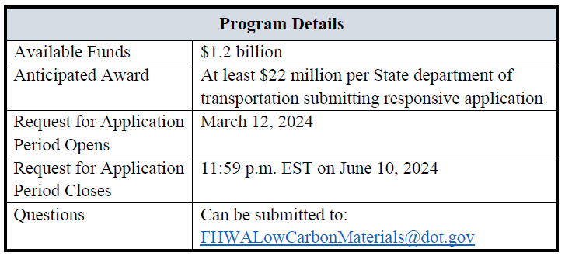
FHWA LCTM Grant
FHWA announce Mid November
MnDOT awarded ~$32 million
Funds available for obligation through Sept 30, 2026
Funds available for expenditure before Sept 30, 2031

Slide 4
LCTM Eligible Projects and Materials
Under this program, funds are available to use on construction projects funded under Title 23 U.S.C., including projects on:
Federal-aid highways;
Tribal transportation facilities;
Federal lands transportation facilities; and
Federal lands access transportation facilities.
For purposes of this program, eligible materials categories are:
  Concrete (and cement),
  Glass,
  Asphalt mix, and
  Steel

Slide 5
Federal Low Carbon Transportation Materials Grant
IRA created funds to facilitate the use of construction materials that have substantially lower levels of greenhouse gas emissions (GHG).
MnDOT has received just under $32 million grant to implement EPDs
  Training and knowledge building
  Procure EPDs
  Manage Organize EPDs
  Advances in quality control and quality assurance for implementation of low carbon materials.
  Contract incentives for low carbon materials
December 16th – MnDOT met with MN FHWA Division Office for kick off meeting
January 10th – MnDOT to meet with MN FHWA Division Office to finalize Grant Agreement

Slide 6
Nuts and Bolts
Training and knowledge building
  Survey to come out soon. What don’t people know?
  Address knowledge gaps with outreach, likely consultant assistance
Procure EPDs
  Pay item in Contract, slow and potentially limited
  Change order at Statewide price potential option

Slide 7
Nuts and Bolts
Manage Organize EPDs
  Numerous national databases exists
  Local or controlled access database
  Links to Material Data Management (MDMS) and AASHTOware.
Advances in quality control and quality assurance for implementation of low carbon materials.
  All good ideas welcome
  Special testing contracts
Contract incentives for low carbon materials

Slide 8
FUTURE
Benchmarking
A + C bidding
Project Carbon Diet
Supply Chain adoption – aggregates, asphalt, additives, bio binders
EPD refinements

Slide 9
Thank You!
Emil Bautista
emil.bautista@state.mn.us

Slide 10
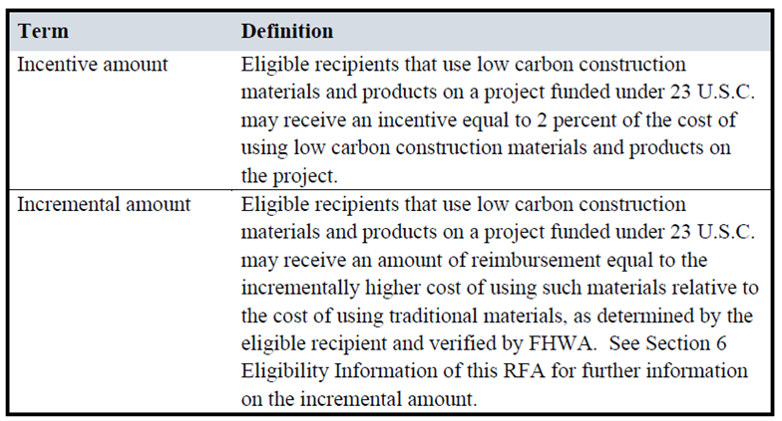
LCTM Funding Methods

Slide 11
MnDOT Application
Task 1: Preparation and Submission of Yearly Reports and IPRs
Task 2: Stakeholder Outreach and Coordination
Task 3: MnDOT and Industry Training
Task 4: EPDs Collection and Storage
Task 5: Thresholds Definition and Identification of Substantially LCTMs
Task 6: Criteria for Incremental/Incentive Amounts and Eligible Construction Project Selection
Task 7: Construction, Quality Assurance, and Specifications Development
Task 8: Development of Green Procurement Policies (GPP)
Task 9: Specifications Update
Task 10: Preparation for Future Developments

